Slide 1
JAXB 2.0 for Data Transformation
Service-Oriented Software Engineering
Software Institute
Nanjing University
Bei Jia

Slide 2
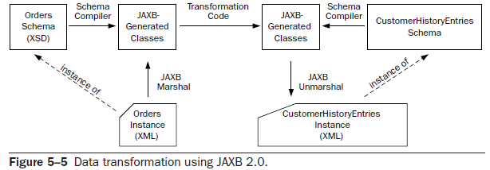
JAXB 2.0 for Data Transformation

Slide 3
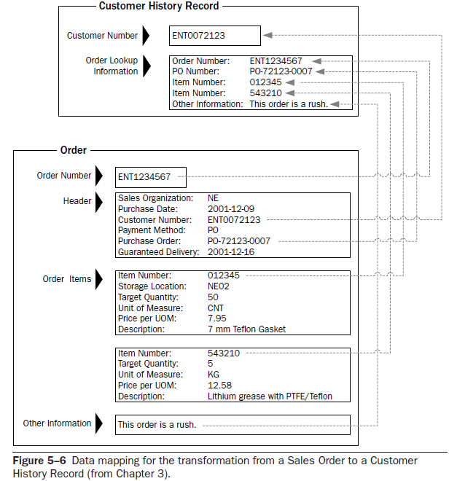
Data Mapping

Slide 4
OrderToCustHistJAXB.java (1/2)
…
Dispatch<Source> getOrdersDispatch =
svc.createDispatch(orderQName, Source.class, Service.Mode.PAYLOAD);
Map<String, Object> requestContext = getOrdersDispatch.getRequestContext();
requestContext.put(MessageContext.HTTP_REQUEST_METHOD, "GET");
Source s = (Source) getOrdersDispatch.invoke(null);
JAXBElement<OrdersType> newOrdersElt =
(JAXBElement<OrdersType>) u.unmarshal(s);
OrdersType newOrders = newOrdersElt.getValue();
List<OrderType> newOrderList = newOrders.getOrder();
CustomerHistoryEntriesType ch = new CustomerHistoryEntriesType();
CustomerHistoryEntryType che = null;
// for each order, create and add a customer history to the list
for (OrderType newOrder : newOrderList) {
che = new CustomerHistoryEntryType();
che.setCustomerNumber(newOrder.getOrderHeader().getCUSTNO());
CustomerHistoryEntryType.OrderLookupInfo orderLookupInfo =
new CustomerHistoryEntryType.OrderLookupInfo();
orderLookupInfo.setOrderNumber(newOrder.getOrderKey());
orderLookupInfo.setPURCHORDNO(newOrder.getOrderHeader().getPURCHORDNO());
orderLookupInfo.setOrderText(newOrder.getOrderText());
…

Slide 5
OrderToCustHistJAXB.java (2/2)
…
// add the item numbers
for (BUSOBJITEM boItem : newOrder.getOrderItems().getItem()) {
orderLookupInfo.getITMNUMBER().add(boItem.getITMNUMBER());
}
// add to the the list history entries
ch.getCustomerHistoryEntry().add(che);
}
JAXBElement<CustomerHistoryEntriesType> chElt =
new JAXBElement<CustomerHistoryEntriesType>(
new QName("http://www.example.com/css","CustomerHistoryEntries"),
CustomerHistoryEntriesType.class,
JAXBElement.GlobalScope.class,
ch);

